Slide 1
Building chatbots with MS Bot Framework
Small Talk Dialog

Slide 2
Copy the files from here
https://github.com/code-monster-kevin/chatbot-102/tree/small-talk-dialog

Slide 3
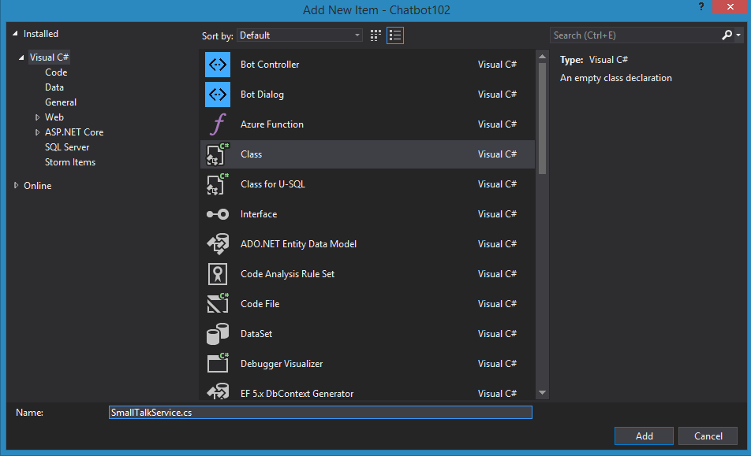
In “Services” folder create “SmallTalkService.cs” class

Slide 4
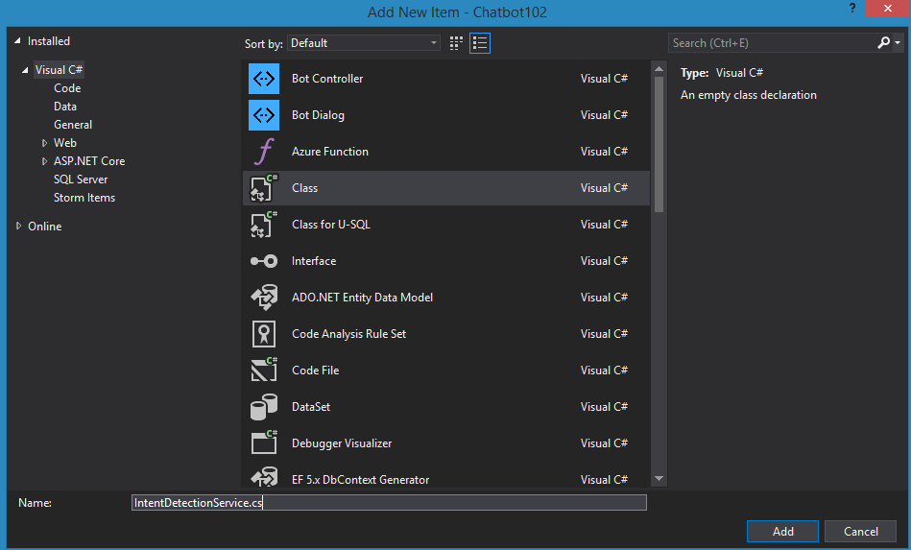
In “Services” folder create “IntentDetectionService.cs” class

Slide 5
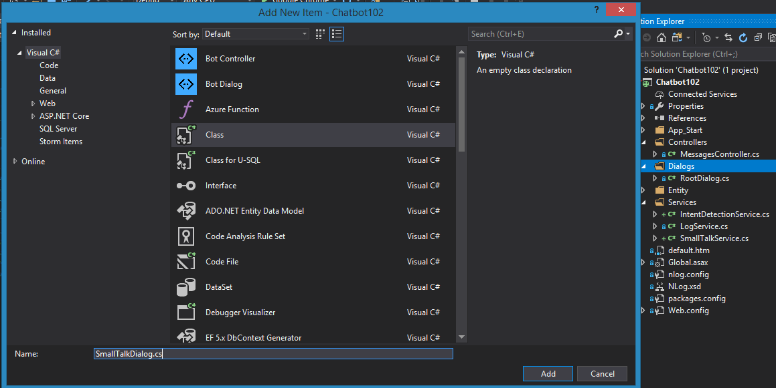
In “Dialogs” folder create “SmallTalkDialog.cs” class

Slide 6
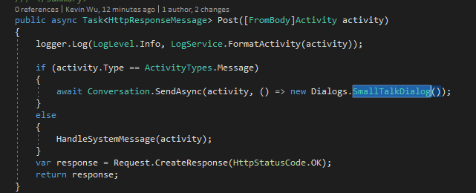
Replace RootDialog with SmallTalkDialog

Slide 7
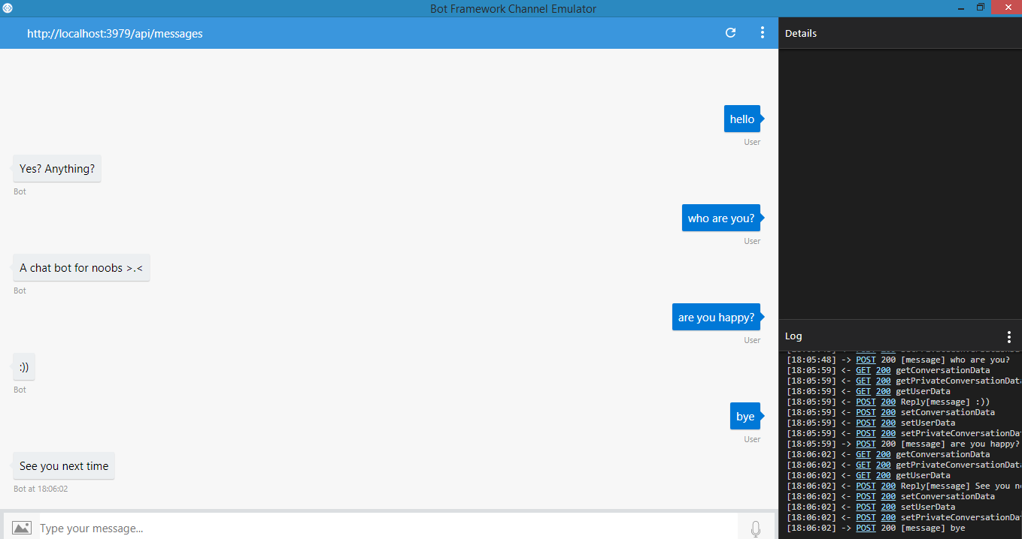
Run the application and test on bot emulator

Slide 8
Basic Conversation Flow
Wait for message from user
Determine Intent
Determine appropriate response
Post response back to connector

Slide 9
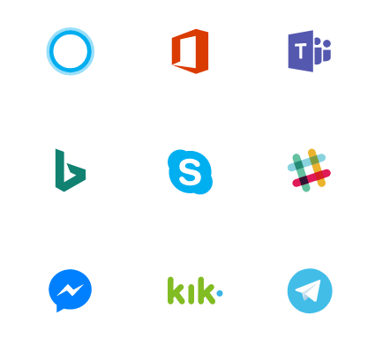
Bot Framework Connector
Bot Connector
Activity
Our Bot Application

